Slide 1
Welcome!
Please sign in!

Slide 2
2023 - 2024 Sport Club Officer Orientation
Monday, September 25, 2023
7:00pm - 10:00pm
Oakes Academic Building Rm 105
Add logo here

Slide 3
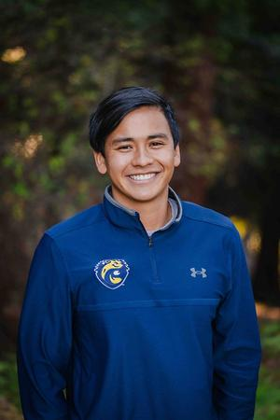
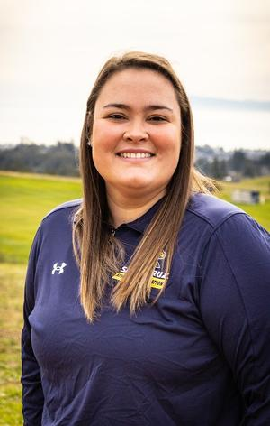
Administration
Dillon Thompson
Associate Director of Athletics & Recreation - Sport Programs
Courtney Sherwin
Assistant Director of Athletics & Recreation - Sport Programs

Slide 4
Competitive Sport Student Supervisors & Program Assistants
Competitive Supervisors
Kevin Encarnacion
Brandon Hernandez
Daniel Mendoza
Nina Reeves
Sofia Perez
Program Assistants
An Nguyentan
Sofia Perez

Slide 5
Primary Advisor
Dillon
Badminton
Ballroom Dance
Camp Kesem
Cycling
Dance Team
Equestrian
Grappling
Men’s Lacrosse
Men’s Rugby
Men’s Water Polo
Muay Thai
Tae Kwon Do
Volleyball
Women’s Soccer
Women’s Water Polo
Courtney
Cross Country
Fencing
Ice Hockey
Judo
Men’s Soccer
Men’s Ultimate
Sailing
Softball
Surfing
Tango
Tennis
Triathlon
Women’s Lacrosse
Women’s Rugby
Women’s Ultimate

Slide 6
Registration
All registration is on https://recreation.ucsc.edu/sportclubs/index.html
Fall Registration
Opened August 1st
Closes December 8th
Winter Registration
Opens January 28th
Closes January 19th
Spring Registration
Opens April 1st
Closes April 12th

Slide 7
High Impact Club Registration Reminder
The following must be completed & approved to be approved active. All links are provided on DSE when you register
Physical Examination
Concussion Vital Signs Baseline Test
Concussion Education (Canvas)
Sports Medicine Profile (SWOL)

Slide 8
Required to Complete Education & Baseline Testing
Cycling
Equestrian
Ice Hockey
Men’s Lacrosse
Women’s Lacrosse
Men’s Rugby
Women’s Rugby
Softball
Men’s Soccer
Women’s Soccer
Men’s Ultimate
Women’s Ultimate
Triathlon
Men’s Water Polo
Women’s Water Polo

Slide 9
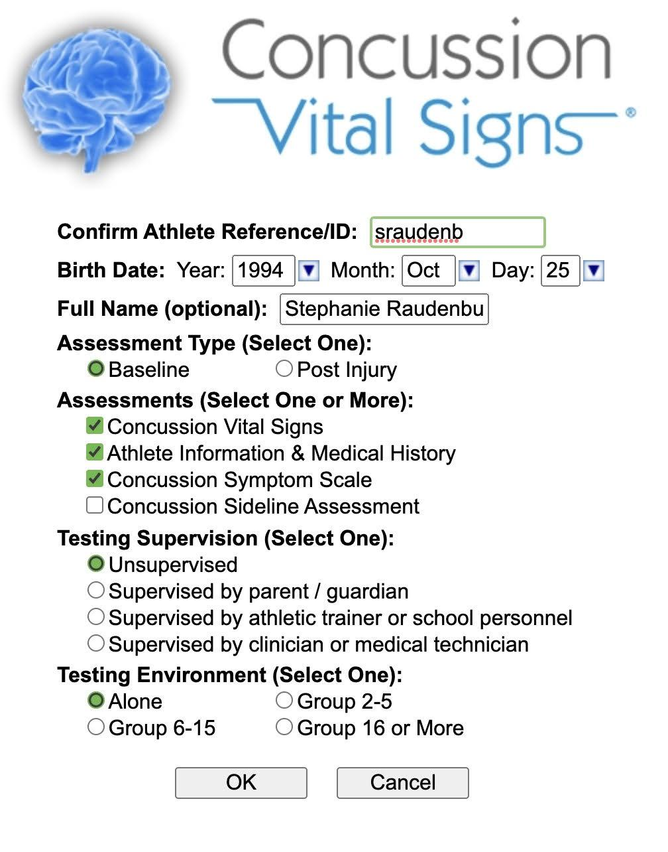

Slide 10
KAHOOT!

Slide 11
All Things Do Sports Easy (DSE)
Registration
Home Competitions
Reporting Home Competitions
Away Competitions (Travel)
Reporting Away Competitions

Slide 12
Events
All events will be put into DSE
HOME & AWAY

Slide 13
Travel - Road Rebel
Complete Itinerary Request Form
Section for hotels, ground transportation and flights
More details the better
Email to jaime.davis@roadrebel.com

Slide 14
Travel - Road Rebel
Jaime will building out team’s dashboard with all budget preferences/room count/concession request, etc.
Flights - options come over within 48 hours
Ground Transportation - option times vary
Rental Cars: 48 hours
Charters: 5-7 business days
Housing - once housing coordinator assigned, her team has 5 days to negotiate rates, gather missing details and present options. Once Jaime approves, email each travel lead an individual option sheets for each trip
First one, schedule a call to go over it in detail and answer any questions. Make sure hotel selections or do second follow ups with hotel

Slide 15
Travel - Road Rebel
Once team likes an option, travel lead will email Jaime back their choice and she sends contracts to the selected vendor(s)
Jaime assist in gathering all documents

Slide 16
Point Based Allocation
Throughout the course of the academic year, clubs will have the opportunity to earn points. In order to earn points, clubs are required to record everything that happens with the club to supplement an annual funding proposal to the Sport Clubs Advisory Committee (see Rule 16).
Presentations will be reviewed by the Sport Clubs Advisory Committee which will establish a recommendation for what each club’s awarded point total will be in each of nine available categories.
Point totals are subject to review by professional staff. Points awarded are counted towards a funding allocation for each club during the next fiscal year.
Funding will be awarded for the next fiscal year based on the cumulative, awarded point total for all clubs. Available funds will be split according to each club’s percentage of the total points accumulated for all Sport Clubs organizations submitting funding proposals before the May 1 proposal deadline.
For example, if a club earns 5% of the cumulative points earned for all clubs, then they will be eligible to receive a maximum 5% of the Sport Clubs available allocation fund.

Slide 17
Point Based Allocation
Sport Clubs reserves the right to award less than the calculated percentage (maximum award calculation) to match a club’s budget proposal, active or inactive status, discipline record, and available funds for allocation.
Sport Clubs organizations may not be awarded more than 75% of their projected operating budget submitted with their annual funding proposal (see Rule 16.e.).
Each club will be responsible for submitting a presentation for the next fiscal year prior to May 1. The Sport Clubs Advisory Committee (SCAC) will review each club funding presentation. The presentation must focus on what points the club should earn accompanied with a detailed, projected budget for the next fiscal year (not the current fiscal year).
Clubs that fail to submit a presentation and present their budget projection are not eligible to receive a funding allocation from Sport Clubs for the next fiscal year.
Clubs that finished a fiscal year in a deficit are subject to either not receiving Sport Clubs funds the following fiscal year or having awarded funds deducted to balance the club’s budget deficit.
In all cases of documentation related to accumulating points the burden of proof lies with the Sport Clubs organization to provide it to the SCAC

Slide 18
Point Based Allocation Categories
Administration
Health & Safety
Game Officials
Community Service
Competitions & Events
Coaches, Volunteers, Instructors
Travel
Team Grade Point Average
Fundraising & Sponsorships
Membership Engagement
Point Deductions

Slide 19
Administration (Maximum 10 points)
In order to gain points in this category, all club members must turn in all documentation prior to appropriate deadlines including but not limited to the handbook agreement, facility requests, travel requests, driver authorizations, roster verification, budget proposals, quotes, etc.
The club must have had zero “After the Fact” transactions occur. The club must also have missed less than three Sport Clubs meetings throughout the school year. +2 points
More than three club officers register for and attend the Fall Sport Clubs Officers Workshop. +1 point
Sport Clubs organization compliant with monthly officer meeting requirements for duration of the academic year. +1 point
Club leadership documents and reconciles all financial activity with Sport Clubs professional staff, including but not limited to completed Event Revenue & Expense forms if applicable, Fund Reconciliation forms, etc. +1 point
Club awarded Sport Clubs organization of the month. +5 points

Slide 20
Health & Safety (10)
One of the high impact activity Sport Clubs organizations that require concussion baseline testing and completely compliant with Athletics & Recreation Athletic Trainers’ requirements. +1 point
Club leadership submits complete and accurate accident and/or incident reports to Athletics and Recreation staff within 48 hours of the occurrence. +1 point
Club has at least two Health & Safety officers certified in CPR/AED/First Aid. +2 points
Club has at least one additional member certified in CPR/AED/First Aid. +1 points
Club has prepared Health & Safety officers and/or certified lifeguards at all practices (verified via practice audits). +4 points
Prepared Health & Safety Officers includes: having an equipped first aid kit at the practice site, completed and valid CPR/AED/First Aid or Lifeguard certification on file with Sport Clubs administration, and knowledge of Sport Clubs professional staff personal contact information in case of emergency.
All club members complete concussion education and baseline testing prior to the first competitive scrimmage or contest. +1 point

Slide 21
Game Officials (7)
One official is required for each game/contest/event. +1 point
Two officials required for each game/contest/event. +2 points
Three officials required for each game/contest/event. +3 points
Four officials required for each game/contest/event. +4 points
Club provides hospitalities to visiting officiating staff. +2 points
Receipts reflecting food for officials required to receive points.
Officials paid through league dues - no additional transactions required. +1 point

Slide 22
Community Service (10)
Volunteer time/labor/services for a non-profit or community-affiliated organization. Community service must be verified via the form found on the Sport Clubs Officer Resource webpage. Clubs may not receive monetary awards in exchange for volunteering for it to count towards points in this category (see Rule 17.ix). This category is capped at 10 points. Individuals that reach 10 hours of service count toward category total.
One member completes one hour of verified community service (cap 10 hours) = 0.1 points
10 members complete 1 hour OR 1 member completes 10 hours = 1 point

Slide 23
Competition & Events (21)
One point for each competition, up to 8 points
Must be with another college or university club organization.
Must have standardized league rules with game officials/judges/administration present and record of competition occurring available to the SCAC.
Must have at least two teams (for team sports) or at least five individuals (for individual sports) present and competing in each competition.
Regional/National competition does not count here, see below for additional point opportunity.
Club has more than two teams within the club competing (example: A & B teams) or at least five unique individuals competing in at least five games/meets/contests or equivalent throughout the year. +2 points
Registered member of a league/association in associated club activity. +1 point
Club qualifies and attends league/regional playoffs or equivalent. +2 points
Winning a national championship as individual or as team. +5 points
Club hosts an organized, sanctioned, and successful tournament, meet, or equivalent with more than two competitors. +3 points

Slide 24
Coaches, Volunteers, Instructors (31)
All Sport Clubs student organizations are to be operated by student club members. All coaches/volunteers/instructors must at the least have Athletics & Recreation volunteer paperwork on file. If the club is planning to pay the coach/instructor they are to be contracted by providing a quote for services to club leadership who will work with Sport Clubs professional staff to complete the agreement.
Exemplified qualifications for a coach/instructor/volunteer. +1 point (2-person maximum)
Burden of proof lies with the club to present to the Sport Clubs Advisory Committee and/or staff.
If a coach/instructor is volunteering time. +1 point (2-person max)
Student members may serve in a coaching/instructional role, however the student must be able to prove exemplified qualifications in the club’s annual funding proposal.
A coach/instructor is paid more than $400 annually for services. + 2 points (2-person max)
A coach/instructor is paid more than $800 annually for services. +3 points (2-person max)
A coach/instructor is paid more than $1200 annually for services. +4 points (2-person max)

Slide 25
Travel (30)
Clubs that travel more often and further distances are eligible to receive points that count towards their funding allocation. The burden of proof for travel lies with each club when submitting their allocation application to the Sport Clubs Advisory Committee.
Each competition where the distance between UC Santa Cruz and visited university is between 200-1,000 miles. +1 point (max 20pts)
Each competition where the distance between UC Santa Cruz campus and visited university is greater than 1,000 miles. +2 points (max 20pts)
Total travel between 1,000-2,000 miles in a year. +1 point
Total travel greater than 2,000 miles in a year. +2 points
At least two additional drivers authorized to drive personal and/or university vehicles beyond minimum requirements. +1 point
Submitting all post travel receipts within 5 business days of trip returning. +1 point
Submitting 50% of post travel reports no more than 3 days after travel. +5 points

Slide 26
Team GPA (4)
Sport Clubs organizations are subject to Sport Clubs administration running a cumulative GPA report on all club members that provides an average, cumulative GPA for all club members during the first week of the spring quarter. Results of the report may be emailed to each respective club president upon request. Individual GPA records will not be shared. Clubs may gain additional points for a high cumulative GPA. The entire club roster is included in this GPA report. The point breakdown is as follows:
Cumulative Club GPA Average of 3.00-3.10. +1 point
Cumulative Club GPA Average of 3.11-3.30. +2 points
Cumulative Club GPA Average of 3.31-3.50. +3 points
Cumulative Club GPA Average of 3.50-4.00. +4 points

Slide 27
Fundraising & Sponsorships (14)
Sport Clubs organizations must fundraise to be able to accomplish many of their goals in competition, apparel, equipment, and other club activities. Sport Clubs is incentivizing fundraising & sponsorships by offering additional points for successful fundraising towards annual funding allocations. This includes funds in both the 70700 fundraising accounts and club foundation accounts (Giving Day funds). Clubs must fundraise a minimum of 35% of their expenses for the current fiscal year to be eligible for points in this category. Budgets include all expenses out of team accounts. Individuals donating or assisting with fundraising do not count as a sponsoring organization. Team dues must be directly related to operational costs of the club. Team dues do not count as fundraising.
Club members pay team dues between $20 - $50 per person on an annual basis. +1 point
Club members pay team dues between $51 - $100 per person on an annual basis. +2 points
Club members pay team dues between $101 - $250 per person on an annual basis. +3 points
Club members pay team dues between $251 - $500 per person on an annual basis. +4 points
Club members pay team dues $501 or more per person on an annual basis. +5 points
Club fundraised at least 50% of expenses during the fiscal year. +3 points
Club fundraised at least 60% of expenses during the fiscal year. +4 points
Club fundraised at least 70% of expenses during the fiscal year. +5 points
Club fundraised at least 80% of expenses during the fiscal year. +6 points
Club sponsored by at least 1 organization outside of UC Santa Cruz during fiscal year valued at more than $150.00. +1 point
Club sponsored by 2-3 organizations outside of UC Santa Cruz during fiscal year valued at more than $150.00 each. +2 points
Club sponsored by 4 or more organizations outside of UC Santa Cruz during the fiscal year valued at more than $150.00 each. +3 points

Slide 28
Membership Engagement (18)
Sport Clubs organizations may earn points in their funding proposals by hosting and verifying participant engagement in healthy bonding activities. For some ideas, please reference Rule 6.e.ix.
Successfully executed recurring, positive team bonding events or other membership/alumni engagement events. +1-10 points possible pending volume of engagement
Sport Clubs organization was represented in attendance at mandatory Sport Clubs workshops. +2 points
Sport Clubs organization was represented in attendance at optional Sport Clubs workshops. +3 points
Post a minimum of 3 posts each quarter and tag @ucsc_sportclubs. +1 point
Post a minimum of 7 posts each quarter and tag @ucsc_sportclubs. +3 points

Slide 29
Point Deductions
Sport Clubs organizations are subject to point deductions, the number of points being deduced are dependent on which policies are violated, and the number of times a policy has been violated.
Submitting travel requests within 12 business days of departure. -1 point
Submitting completed travel rosters within 4 business days of departure. -1 point
Submitting facility requests after quarterly deadline. -1 point
Member found improperly registered during practice audit. -1/member
Failure to document and properly report an incident during club operation. -1 point
Failure to meet with Sport Clubs professional staff for a monthly club officer meeting. -1 point
Failure to provide representation in attendance at mandatory Sport Clubs workshops. -1 point

Slide 30
Sports Club Advisory Committee (SCAC)
Ryan Thayer | Men’s Lacrosse
Mary White | Women’s Lacrosse
Vacant | Vacant
Vacant | Vacant
Vacant | Vacant

Slide 31
Interested? Scan Here

Slide 32
Important Dates
Registration
Fall Registration
Opened August 1st
Closes December 8th
Winter Registration
Opens January 28th
Closes January 19t
Spring Registration
Opens April 1st
Closes April 12th
Training & Workshops
Driver Authorization Training
Wednesday, October 4
4:00pm
TBD
Facilities with Cayla
Thursday, October 12
5:00pm - 6:30pm
Via Zoom
Finance with Cristen
Friday, October 13
6:00pm - 7:30pm
Slug Space, East Field House
Marketing & Branding with Clint
Monday, October 16
5:00pm - 6:30pm
Via Zoom

