Slide 1
Student Employment & Work-Study Orientation

Slide 2
Career Center Overview
Part-time jobs (on and off campus)
Workshops
Internships & full time employment
Career fairs every quarter
Resume/cover letter critiques
Applying to graduate /professional school
One-on-one advising appointments

Slide 3
One-on-One Advising by Discipline
Arts &Humanities
Social Sciences
Science, Technology, Engineering, & Math, (STEM) and Pre Health
Pre-Law
Graduate Students
Peer advising: General Peer Advisers,
Pre-Health and Pre-Law Peer Advisers
Make appointments
through SLUGQUEST

Slide 4
Career Advisers can help you
Choose a major & link majors to careers
Explore career options & develop your career goals
Search for internship & employment opportunities
Apply to graduate & professional school programs
Prepare for the job search (resume, interview, etc.)
Be proactive about your future!
The sooner you come visit us, the more prepared you will be!

Slide 5
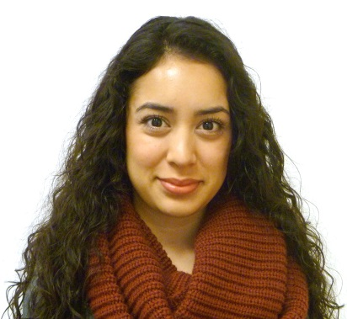
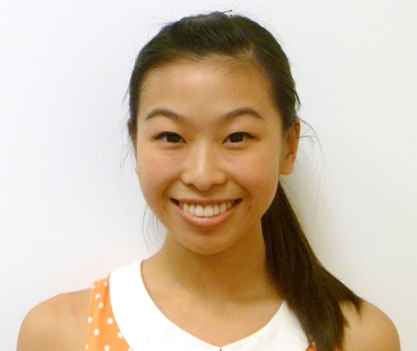
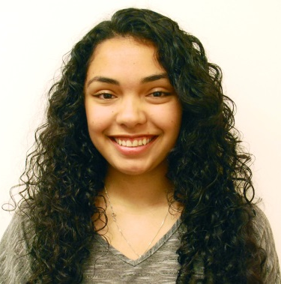
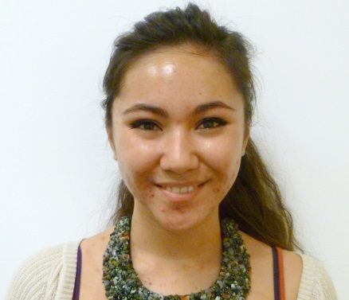
Career Center Peer Advisers
Xiomara Garcia
Amy Yu
Karina Ortiz
Samantha Hamilton
Resume/Cover Letter and Career Center Resources
Peers are available by drop-in only
M-F, 10am-12pm & 2pm-4pm
First come, first served
careers.ucsc.edu

Slide 6
careers.ucsc.edu
Annual Events
Meet the Firms- Fall
Computer/Engineering Career & Internship Fair –Fall/Winter
Graduate & Professional School Fair- Fall
Job & Internship Fairs -Fall, Winter, Spring
Meet the Districts - Winter
Social Justice Fair – Winter
Careers in Education - Spring
Workshop Topics (offered every quarter)
Resumes and Cover Letters
Internships
Choosing a Major
Job Search
Applying to Graduate & Professional School
Job Interview
LinkedIn
Job Fair Prep

Slide 7
Career Exploration
On-Campus Interviews (OCI)
Information Sessions
Multicultural Career Conference (MCC)
Career Advice Network (CAN)….coming soon!

Slide 8
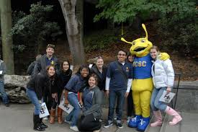
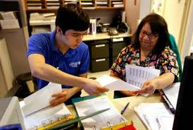
GET INVOLVED
We can help!
Volunteer
Field Study
Internship
Research
PT job
Form relationships
with faculty
Join a club/team
What is going to be on your resume?

Slide 9
Jobs and Internships
On-Campus and Off-Campus Work-Study Jobs
Off-Campus Jobs and Internships
And advising, career fairs, workshops…

Slide 10
Work-Study
Apply through FAFSA
Awarded by Financial Aid
Viewable on Portal
Employer pays 50% of wage, work-study pays other half
Can use only during school year

Slide 11
Work-Study
Can use for more than one work-study job on first-come, first-served basis
Work with supervisor to keep track of funds!

Slide 12
Work-Study
When work-study award runs out:
Supervisor might convert job to non-work-study
OR
Job might end

Slide 13
Top On-Campus Employers
Dining Hall
Library
OPERS
Cafés
Labs
*Word of mouth!*
Not all on-campus positions are advertised in the ER system!
Talk to departments, friends, roommates, RA’s, etc.

Slide 14
Work Schedule
19 hours during school year
40 hours during summer or quarter breaks

Slide 15
Work Schedule
Employers will work around your class schedule
Communicate with supervisor about changes to class schedule
Notify supervisor if you can’t work scheduled hours
Be on time!

Slide 16
Want to be noticed? Application Tips
Punctuation, spelling, capitalization and grammar ALL COUNT!
Fill out the application COMPLETELY – leave nothing blank. If the section doesn’t apply to you, mark it N/A.
Copy and paste a cover letter and resume in the additional section of the application.
Follow directions

Slide 17
The Hiring Process

Slide 18
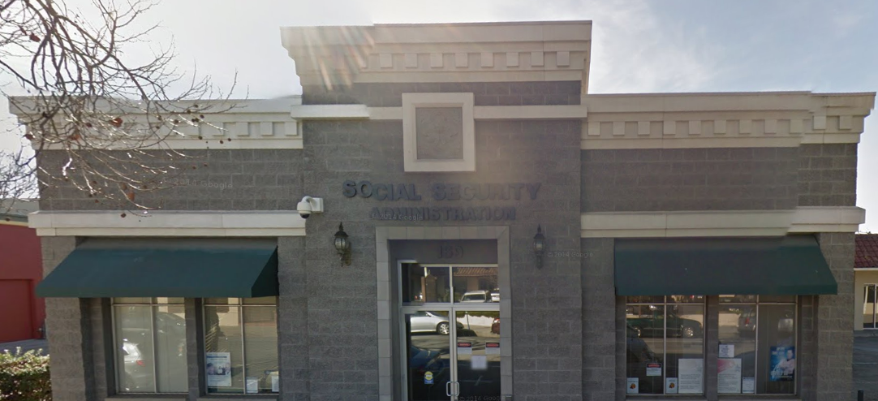
The Hiring Process
If you don’t have a List C document:
Social Security Card replacement is free
Downtown Santa Cruz, 169 Walnut Avenue

Slide 19
The Hiring Process
Complete paperwork
Receive Blue Card
START WORKING

Slide 20
Receiving Your Paycheck
Bi-weekly pay check
Paper check delivered to college office – NOT mailbox
Direct deposit automatically deposits check into bank account
Get paid earlier
Never miss a paycheck

Slide 21
careers.ucsc.edu

Slide 22
Thank You! Good Luck with Your Job Search!
Career Center
(831) 459-4420
careers.ucsc.edu

